Slide 1
What do the following images have in common?
See if you can find a connection!

Slide 2
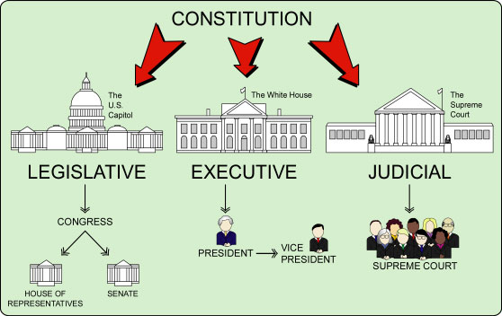
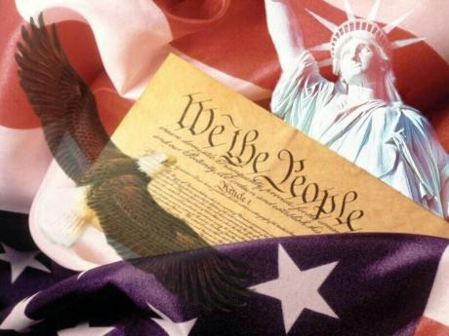

Slide 3
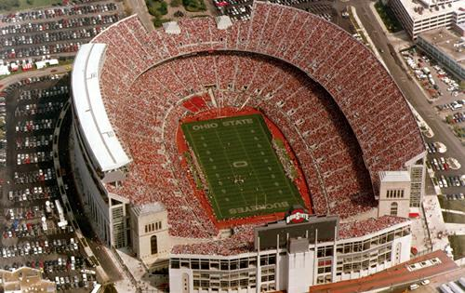
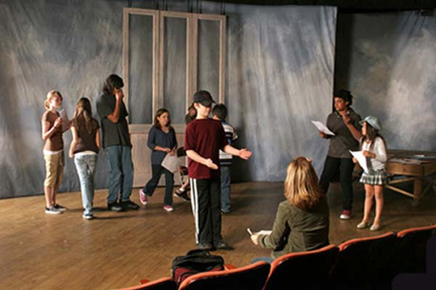

Slide 4
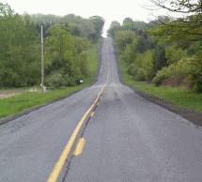

Slide 5
What do they have in common?
Do you know?

Slide 6
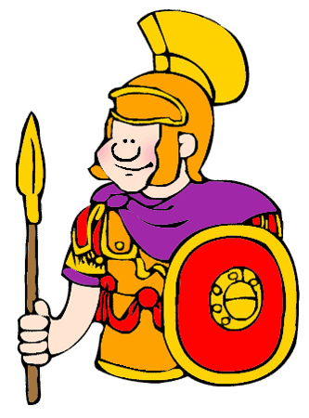
Answer: The Roman Empire
All of the previous images show things that were first developed or perfected by the Roman Empire.
Many things or ideas that we have or use today has been heavily influenced by the Roman Empire.

Slide 7
Learning Target:
I can explain the origin of the Roman Empire.
I can explain the republic of the Roman Empire.

Slide 8
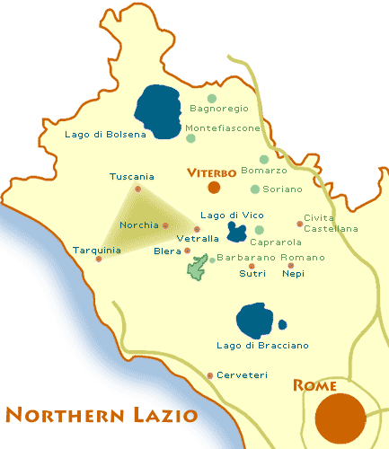
Rome was originally a Monarchy
In 600 B.C., the Romans were ruled by a group of people called the Etruscans.

Slide 9
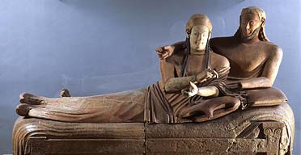
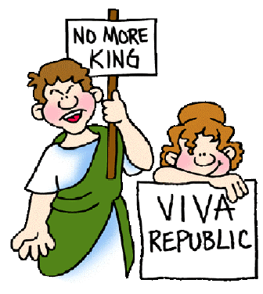
The Etruscans
No one knows where the Etruscans came from.
The Roman “toga” came from the Etruscans.
The Etruscans ruled as kings until the Romans revolted and overthrew them in 510 B.C.
The Romans place a republic in place of a monarchy.

Slide 10
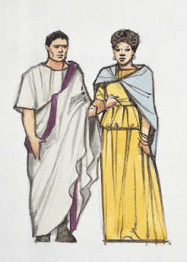
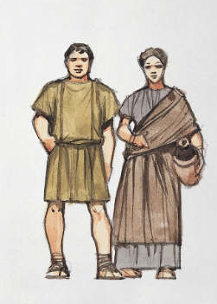
After the Etruscans
The people of Rome now govern themselves. There are two types of citizens in Rome:
Patricians – very wealthy and noble people
Plebeians – common, ordinary people that ranged from the poor to middle-class

Slide 11
The Roman Republic: A tripartite system
The Roman government is divided into three pieces.
1.) The Assembly
2.) The Senate
3.) The Consul

Slide 12
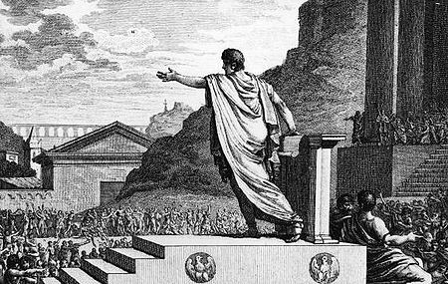
The Assembly
The assembly was made up of the common man. Every citizen was able to be a member of the assembly.
The assembly gathered into a public place called “The Forum” where they would make votes.
Tasks of the assembly:
vote on new laws suggested by government officials
declare war or peace
elect government officials
elect two members of the senate to spend a one year term as consul

Slide 13
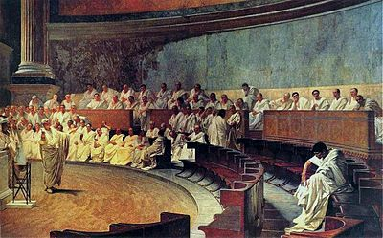
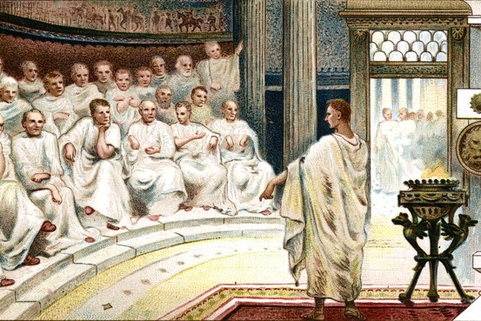
The Senate
The senate was made up of 300 patrician males.
Once you were elected to the senate, you were a senator for life.
The senate gave advice to the consul and the assembly;
sometimes they voted to override decisions of the assembly
consuls usually did what the senate advised.
The senate made decisions that dealt with foreign nations.

Slide 14
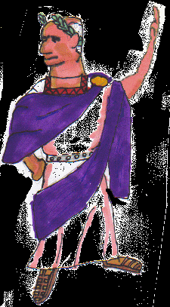
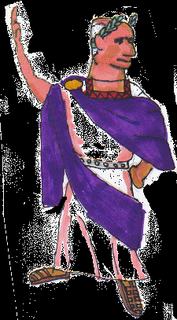
The Consul
Every year, the assembly voted on two members of the senate to be elected to consul. The members of consul would serve a one-year term and then not be eligible to be consul again for another ten years.
The consul acted as judges, chose new members of the senate, oversaw the entire government, its officials, set taxes, and directed the army.
The main job of the consul was to command the army, make sure a set amount of taxes were paid, and see to it that the laws of the empire were being carried out properly.

Slide 15
Emergencies
In times of emergency, the consul could agree to choose a dictator.
The dictator would have supreme rule over the empire for only six months to get the empire back on its feet.
At the end of the six months, the Roman Empire would go back to its usual government or elect another dictator.

Slide 16
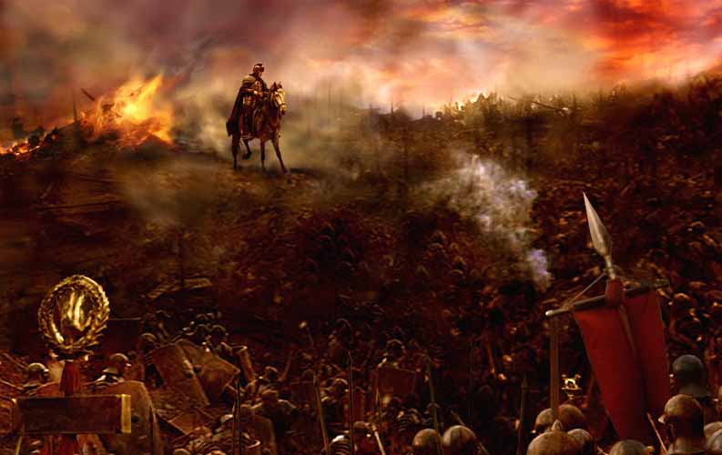
The Punic Wars
Notes:
16

Slide 17
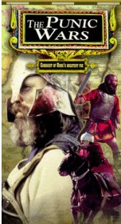
The Punic Wars
Eventually Rome and Carthage began to fight over trade in the Mediterranean Sea
They fought 3 wars
Notes:
17

Slide 18
The First Punic War 264 BC-241 BC
Fought over Sicily for 23 years
Carthage lost
This was Rome’s first province
Notes:
18

Slide 19
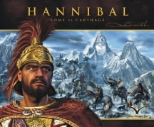
The Second Punic War 218 BC – 202 BC
Carthage was led by HANNIBAL a brilliant general.
He used 50,000 men, 9,000 cavalry and 60 elephants.
To surprise Rome he went through the Alps
Notes:
19

Slide 20
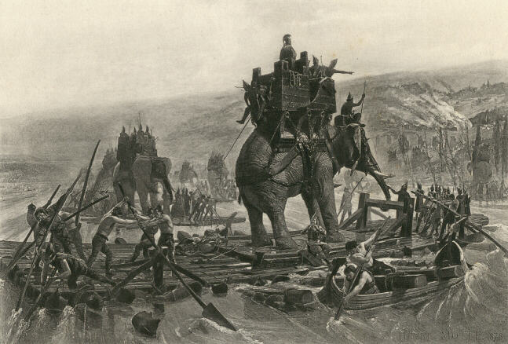
Notes:
20

Slide 21
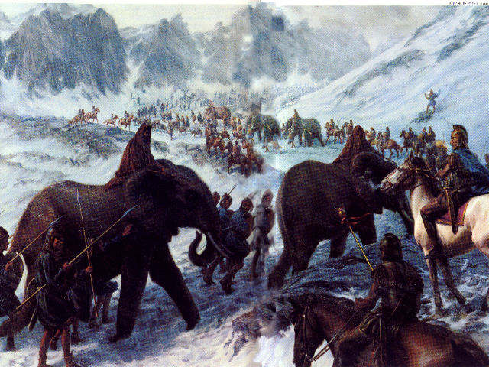
Notes:
21

Slide 22
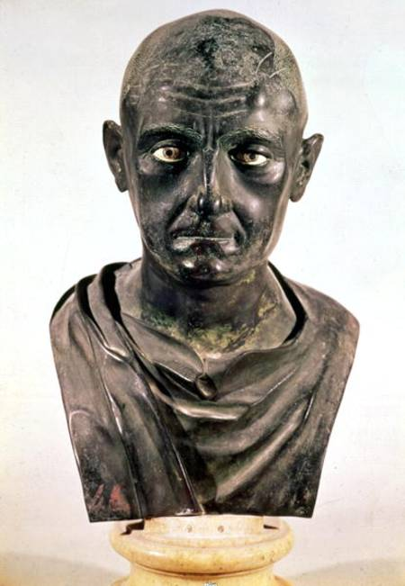
The Second Punic War
For 15 years, Hannibal moved across Italy dominating
Finally a Roman general name SCIPIO defeated Hannibal.
Notes:
22

Slide 23
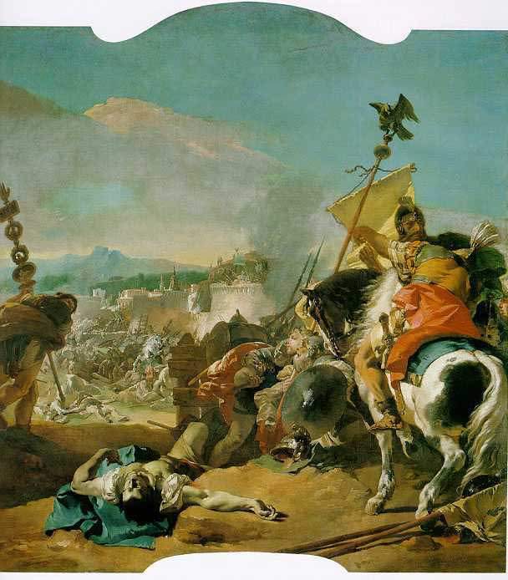
The Third Punic War 149 BC -146 BC
Cato an influential senator reminded them of the terror Hannibal laid on Italy.
By this time, Carthage was no longer a threat.
Romans destroy Carthage and sold all of Carthaginians into slavery!
Notes:
23

Slide 24
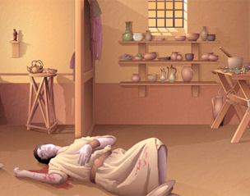
All Good Things Come to an End
This style of the Roman republic lasts from about 510 B.C. to about 120 B.C.
Disagreements and fighting about breaking up rich estates to give land to the plebeians causes fighting among the plebeians and patricians. The patricians have some plebeians murdered.

Slide 25
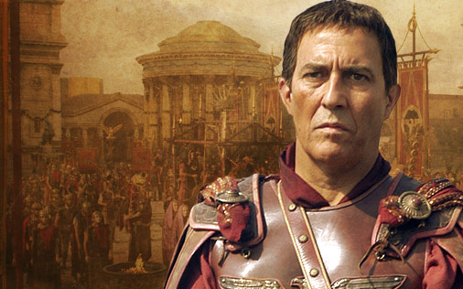
Chaos Ensues
After 120 B.C., there is chaos and civil war in Rome.
The consuls no longer respect each other’s right to veto.
Generals begin to gather private armies and fight for control of Rome.
As Rome was about to become extinguished, Julius Caesar rises up to become a powerful leader who restores peace and prosperity to Rome by becoming Rome’s very first emperor.
As emperor, Julius Caesar declares himself dictator of Rome for the rest of his life.

Slide 26
Learning Target:
I can explain the origin of the Roman Empire.
I can explain the republic of the Roman Empire.

