Slide 1
Asia Review

Slide 2
East Asia
Geographical Features caused China to remain Isolated and uniform when most other civilizations became “melting pots” of languages and cultures.

Slide 3
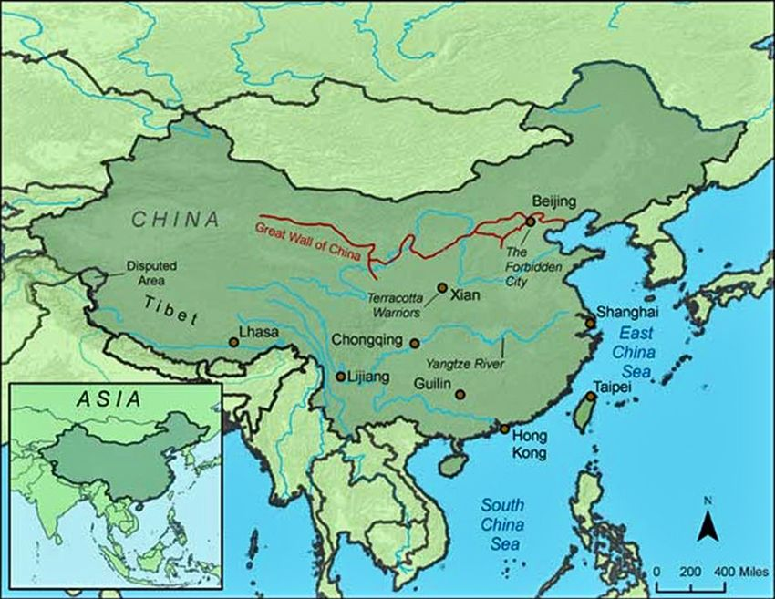
East Asia
The Great Wall of China was built to protect the Chin Empire from raiders in Mongolia.

Slide 4
A dynasty is when one family monopolizes the throne for centuries. Chinese dynasties make up a large part of their history.

Slide 5
East Asia
The Silk Road helped connect China and surrounding countries with almost all of Asia and even Europe – it was all about TRADE.

Slide 6
East Asia
Samurai were Japanese warriors trained to be bodyguards for the nobles.

Slide 7
East Asia
Communism was adopted by some East Asian countries as they adapted from life of dynasties.
Communism is when the government owns and controls all the means of production.

Slide 8
Asia
Monsoons are seasonal winds of the Indian Ocean and southern Asia, commonly marked by heavy rains in the spring and summer.

Slide 9
South Asia
Caste system – the division of people in ancient and modern India into various social classes.

Slide 10
South Asia
The Himalayas prevented Indian culture from spreading throughout Asia

Slide 11
South Asia
The British colonized India and surrounding areas to exploit the area’s natural resources.
British colonialism in India led to:
Railroads being built
English language being spoken
English law and government being used

Slide 12
South Asia
India wanted independence.
Mahatma Gandhi was an Indian lawyer (studied in London) who decided to use non-violent protest (civil disobedience) to fight for independence. This is known as satyagraha.

Slide 13
South Asia
Job out-sourcing to India and other nations has a major impact on U.S. economics.

Slide 14
Asia
Not all countries have the same child labor laws
The major negative consequence of child labor – no education.

