Slide 1
“Blood” Diamonds in Sierra Leone

Slide 2
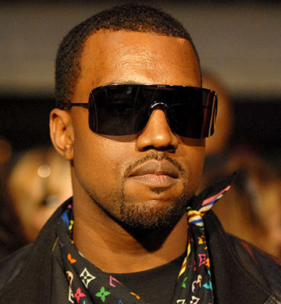
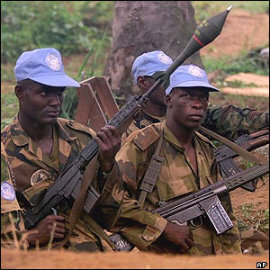
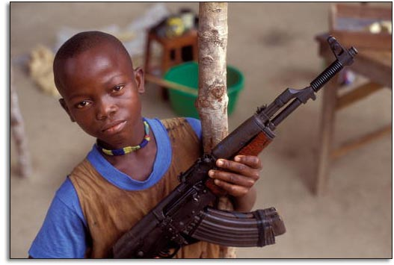
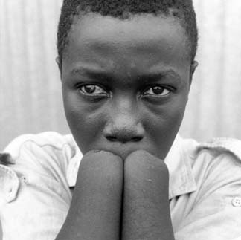
What links these people?

Slide 3
What are blood diamonds?
What do you think a blood diamond is?

Slide 4
The UN state blood diamonds are…
United Nations definition- "...diamonds that come from areas controlled by forces against fair and internationally recognized governments, and are used to fund military action against those governments.“
But what does this mean?!

Slide 5
Blood diamonds are…
From areas controlled by rebel groups rather than governments.
Sold to raise money to buy weapons or fund civil war by these rebel groups.

Slide 6
Historical Background
Resource curse: a country has many natural resources such as diamonds but is not very developed and has a history of conflict
The diamond fields in Sierra Leone were originally controlled by the government and a company called DeBeers
Government officials in Sierra Leone were rich
People working in the mines were poor
Nicky Oppenheimer-
Chairman of DeBeers

Slide 7
Conflict
Who? Rebel Groups & Militaries, Diamond Consumers
Revolutionary United Front
(RUF): a rebel group in Sierra Leone
Why Conflict? All are trying to gain control of the countries diamond mines to fund and fuel war and controversy

Slide 8
Which countries are involved in this?
Sierra Leone
Democratic Republic of Congo
Angola

Slide 9
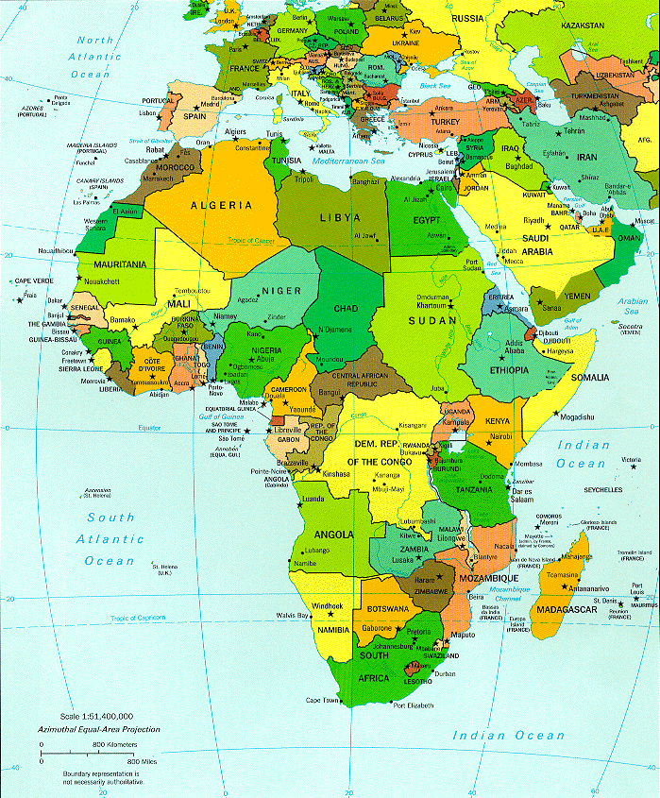
Sierra Leone
Sierra Leone is in West Africa.
It is one of the least developed (poorest) countries in the world.

Slide 10
Consequences
Child Soldiers
Abducted to fight for the rebels
Keep people in line
Given drugs so they are fearless
Villages attacked when…
Support the government
In opposition of rebels

Slide 11
Consequences
Terrify the local populations
Amputate one or both arms with machetes – no longer can work
Forced into Slavery
Shootings

Slide 12
Solutions
Kimberley Process
Certification
Tracks diamonds from the mines to the counter where they are sold
Consumers should ask for proof
Awareness

Slide 13
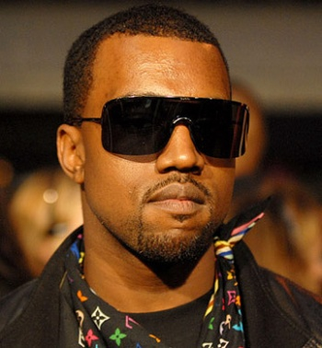
What does Kanye West have to do with blood diamonds?
Kanye West wrote a song to increase awareness of blood diamond in Sierra Leone.
Listen to the song and follow
the lyrics to see if you can
hear anything about the
issues.

Slide 14
What does Kanye West have to do with blood diamonds?
https://youtu.be/e6vn5B5nL-Q

Slide 15
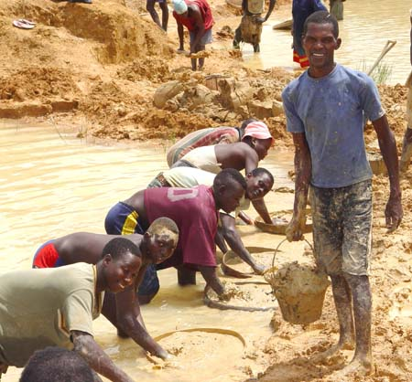
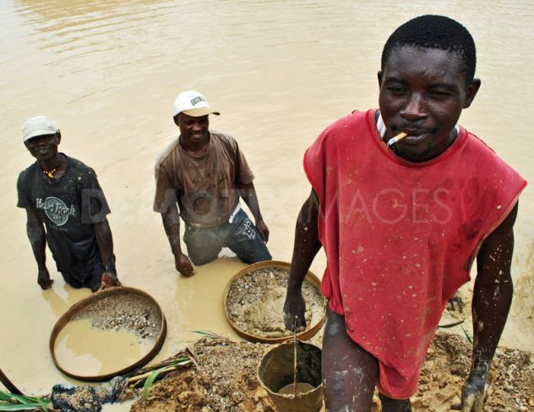
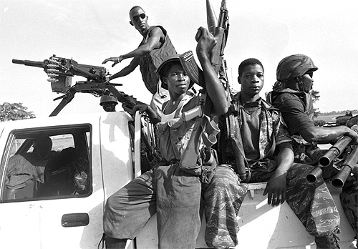
Creating our own rap or poem
Using what you have found out today about blood diamonds create a rap or poem showing the issues surrounding diamonds!!!

Slide 16
Writing your rap or poem
You must use at least 5 key words.
You must not include any swearing or inappropriate words!!!
Key words-
Rebels
Revolutionary United Front (RUF)
“Blood” or “Conflict” diamonds
Child soldiers
Terrorize
Civil War
Resource
Curse
Amputate
Government
Fear
Sierra Leone

Slide 17
Lets hear some!!!

