Slide 1
Hammurabi’s Code
1700s BCE

Slide 2
Evaluation of Evidence
We must evaluate all evidence
To evaluate evidence, we ask:
Why is a document useful?
What are its limitations?
What other information do we need?

Slide 3
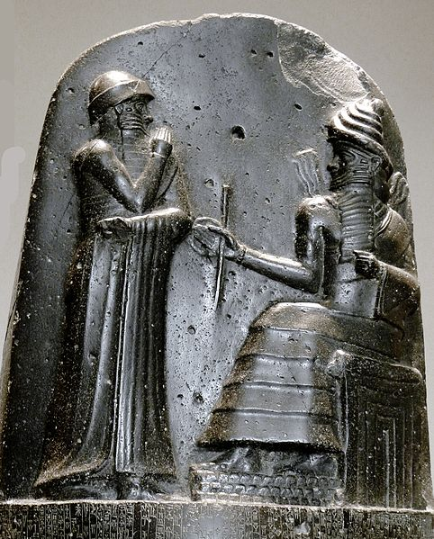
Who was Hammurabi?
Member of the Amorite dynasty
King of Babylon from 1792-1750 BCE
United all of Mesopotamia under the Babylonian Empire
Relief of Hammurabi and the god Shamash

Slide 4
Hammurabi’s Code
Laws for Babylonian society
Tool to unify expanding empire
“That the strong might not injure the weak”
Allowed everyone to know the rules

Slide 5
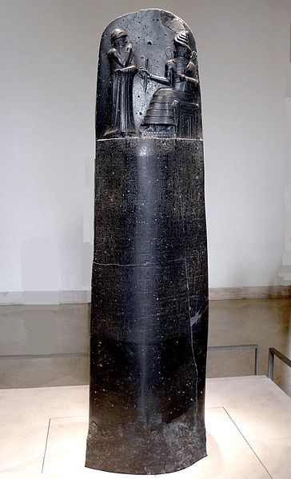
What does it look like?

Slide 6
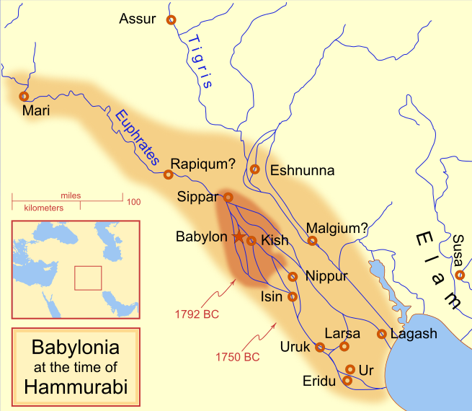
Loss and Unearthing

Slide 7
Central Historical Question
What can we learn about Babylonia from Hammurabi’s Code?

