Slide 1
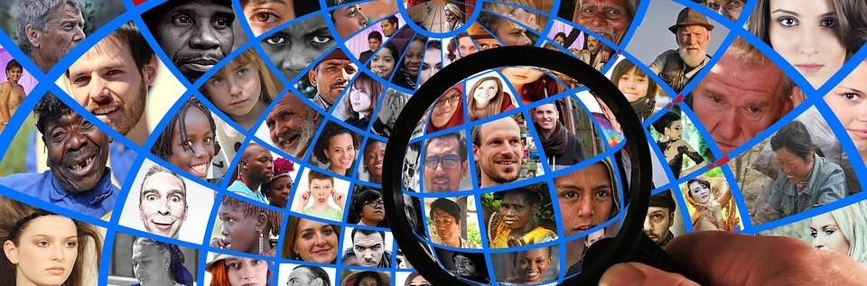
What are Human Rights?

Slide 2
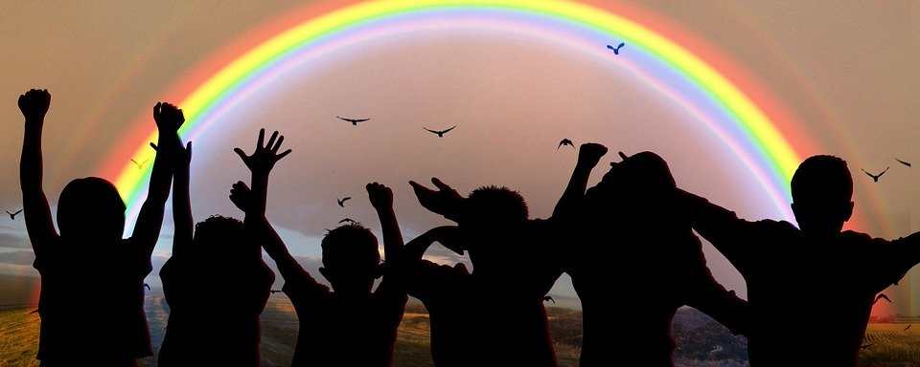
Definitions
Definition #1: “human rights are rights inherent [belonging] to all human beings, regardless of race, sex, nationality, ethnicity, languages, religion or any other status” -United Nations
Definition #2: “The basic rights and freedoms that belong to every person in the world from birth until death. They apply regardless of where you are from, what you believe or how you choose to live your life.” -Equality and Human Rights Commission
What are the similarities/differences between these two definitions?
Is there anything you think is missing?

Slide 3
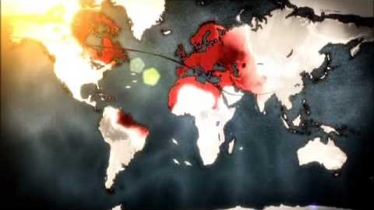
Human Rights Video
As you watch the clip, ask yourself the following questions:
Why do different people have different ideas of what human rights are?
What is the Universal Declaration of Human Rights?
https://youtu.be/oh3BbLk5UIQ

Slide 4
Let’s Discuss
Which of these rights are necessary for survival? How are needs and rights related?
Should human rights address only what a human being needs to survive? Why or why not?
What would happen if you had to give up one of these rights?
What happens when a person or government attempts to deprive someone of something that is necessary to human dignity?
→ What are some violations to these rights in the world/USA/community/school? What UDHR rights are being violated?
→ What actions can you take to help meet the basic needs of others in your community?

Slide 5
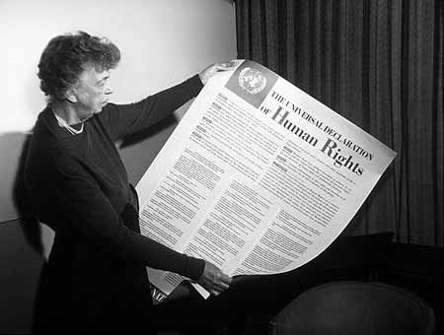
The Universal Declaration of Human Rights (UDHR)
United Nations (UN) established in 1947 following World War II to avoid the cruelty of the Holocaust
Eleanor Roosevelt was on the drafting committee
The UN adopted the UDHR on December 10, 1948
The preamble gives the reasons for its creation
Articles 1-30 define the rights
First document signed by different countries to agree to the protection of people’s rights
UN Photo
Eleanor Roosevelt with the UDHR

Slide 6
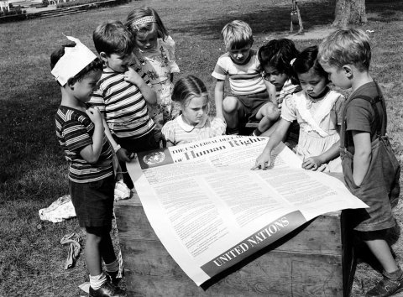
Which of the rights you listed, are also mentioned in the UDHR?
UN Photo
In 1950, on the second anniversary of the adoption of the Universal Declaration of Human Rights, students at the UN International Nursery School in New York viewed a poster of the historic document.
https://www.un.org/en/sections/universal-declaration/history-document/index.html

