Slide 1
Journal Write #10 September 18/21
If a friend says, “ I am sick of shoveling my driveway every year!” Is your friend more likely tired of the weather or the climate? Explain why? 2-3 sentences
The six characteristics of weather are Precipitation, Wind, Temperature, Humidity, Atmospheric Pressure & Clouds.Which of these listed are the two main factors when determining climate?
Look at the two maps on the board. What is the difference in average temperature during the winter between Salt Lake City Utah and Jacksonville Florida?
Now look at the average precipitation of both states. What is the difference in monthly precipitation?

Slide 2
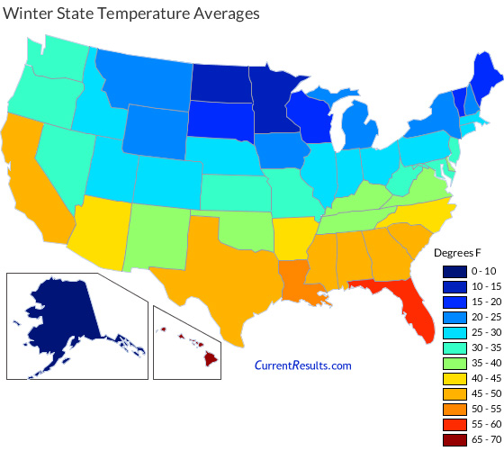

Slide 3
