Slide 1
Parallel Lives
Athenian Female vs Spartan Female
http://www.ancientgreece.co.uk/dailylife/story/sto_set.html

Slide 2
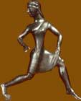
Daily Life
Daily Life
Life in ancient Greece was quite different for men and women. Whilst men were expected to take an active part in the public life of their city, women were expected to lead a private life as wives and mothers. Their lives were centered on the home.. Families of reasonable wealth would have slaves to carry out the household chores, to go shopping at the market and even to help bring up children.
A lot of our information on daily life comes from pottery, and in particular from the scenes painted on pots to decorate them.
However, daily life in Sparta was rather different from most other city-states. Here women led more active lives, as this would improve their physical strength and their ability to have healthy babies. Sparta also had slaves but these belonged to the city as a whole, rather than to individual families.
 |  | Life in ancient Greece was quite different for men and women. Whilst men were expected to take an active part in the public life of their city, women were expected to lead a private life as wives and mothers. Their lives were centred on the home.

Slide 3
Daily Life Continue
Slavery was a central feature of life in Greece. Families of reasonable wealth would have slaves to carry out the household chores, to go shopping at the market and even to help bring up children.
However, daily life in Sparta was rather different from most other city-states. Here women led more active lives, as this would improve their physical strength and their ability to have healthy babies. Sparta also had slaves but these belonged to the city as a whole, rather than to individual families.
A lot of our information on daily life comes from pottery, and in particular from the scenes painted on pots to decorate them.

Slide 4
Spartan Male VS Athenian Male
Please answer the questions in order.

Slide 29
Spartan Female VS Athenian Female
Please answer the questions in order as you read.

Slide 49
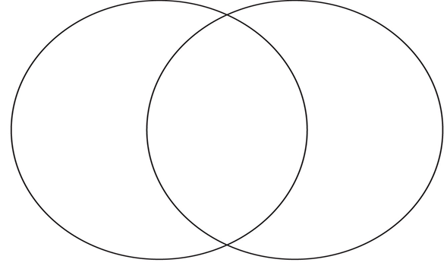
.
How well do you understand the major differences between Athens and Sparta? Enter the various characteristics distinct to each people as well as the characteristics they shared into the
Venn Diagram.
Remember that in a Venn Diagram the part of the circles that overlap in the middle are characteristics shared by both communities.

