Slide 1
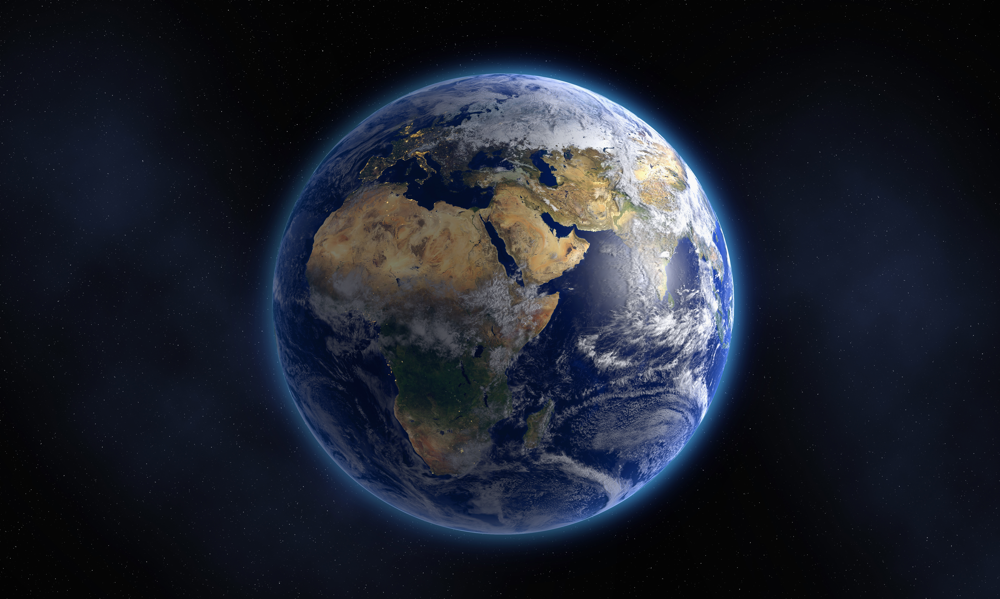
Physical Geography Review

Slide 2
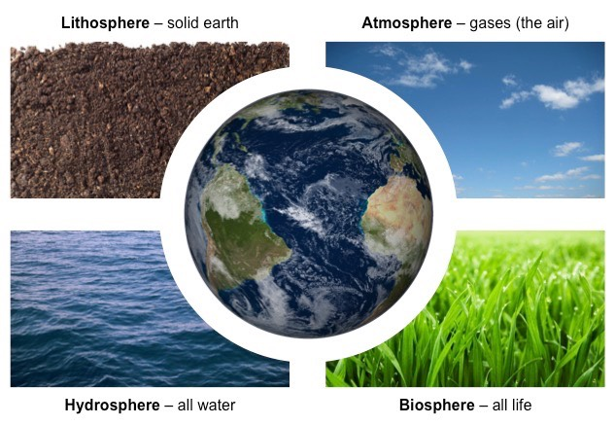
The Four Spheres

Slide 3
The Four Layers

Slide 5
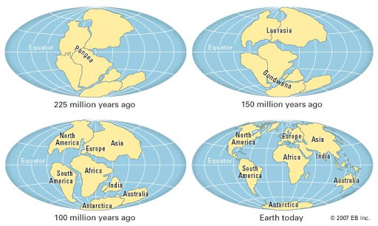
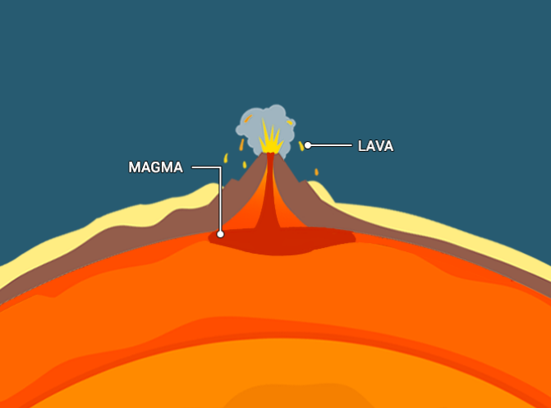
Tectonic Activity
Continental Drift – the process by which tectonic plates slowly move across the upper mantle.
Magma – liquid rock below the earth’s surface
Lava – liquid rock above the earth’s surface

Slide 6
The hydrologic cycle

Slide 7
Water of the world

Slide 8
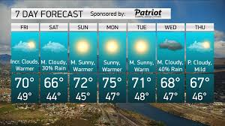
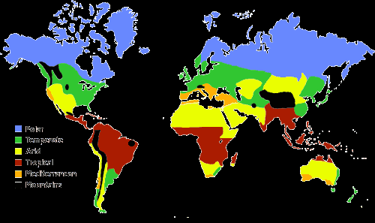
Climate and weather
weather
climate
The condition of the atmosphere in one place during a short period of time
Weather conditions over a long period of time

Slide 9
Factors of both Climate and Weather

Slide 10
Where are different types of climates located?

Slide 11
Earth’s resources

