Slide 1
Population and Culture Review

Slide 2
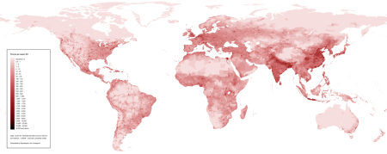
Population
Population Density
The average number of people per square mile
Asia and Europe
The two most densely populated continents today
Birth Rate
The number of babies born per year per thousand people

Slide 3
Population
Population Pyramid
Graph showing population based on age and gender.
How many males are between the ages of 5-9?
How many females are between the ages of 35-39?

Slide 4
Culture
Culture
All of the features that make up a person’s way of life
Common language, religion, and ancestry are defining characteristics of an ethnic group and are parts of culture.
Culture Hearth
The geographic center where ideas, practices, and beliefs begin/develop

Slide 5
Culture
Innovation
The changing of culture through new ideas and technology
Diffusion
The spread of material and non-material characteristics from one culture to another
Globalization
The process in which connections around the world increase and cultures become more alike
Information revolution (internet, social media, etc.) has sped up globalization

Slide 6
Culture
Material Culture
Refers to the physical objects, resources, and spaces that people use to define their culture
Non-material Culture
Examples of non-material culture include any ideas, beliefs, values, norms that may help shape society
Thanksgiving, Islam, and the French language are all specific types of non-material culture

