Slide 1
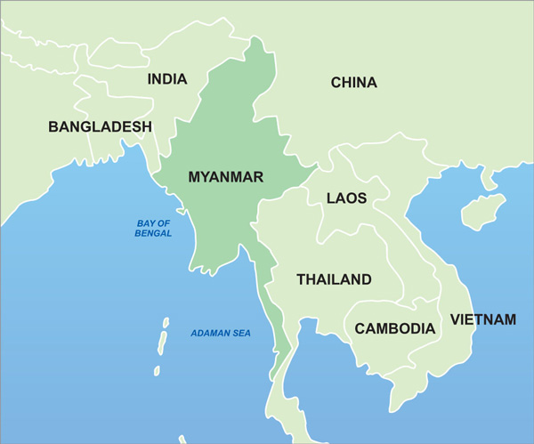
Rohingya crisis
in Myanmar

Slide 2
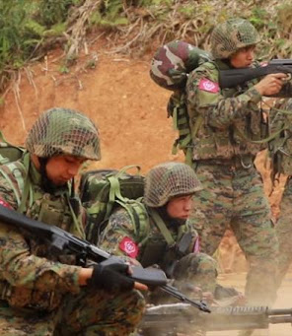
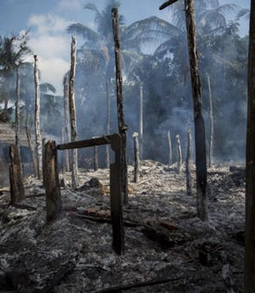
Image Credit: AFP/Mizzimia
Image Credit: Stringer/Reuters

Slide 3
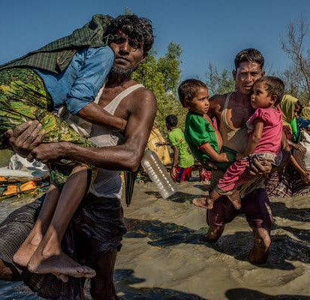
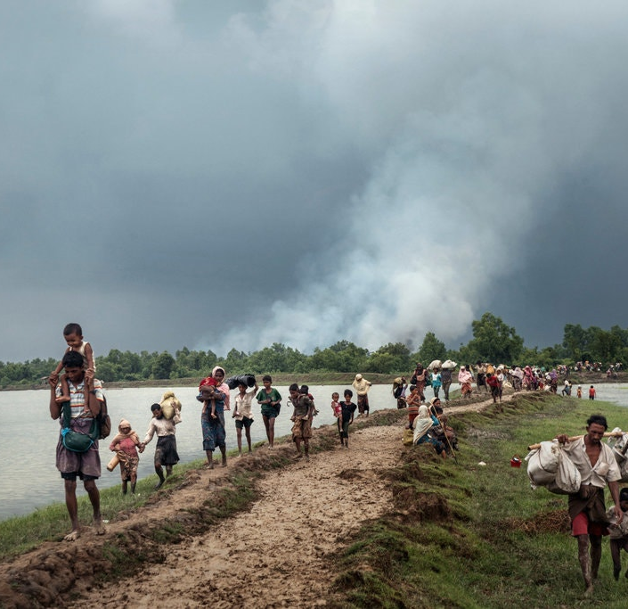
Image Credit: Adam Dean for The New York Times
Image Credit: Tomas Munita for The New York Times

Slide 4
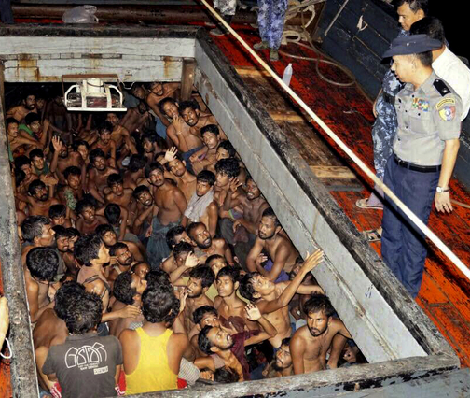
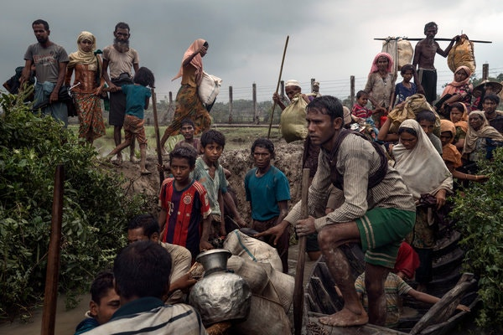
Myanmar Information Ministry/EPA
Image Credit: Adam Dean for The New York Times

Slide 5
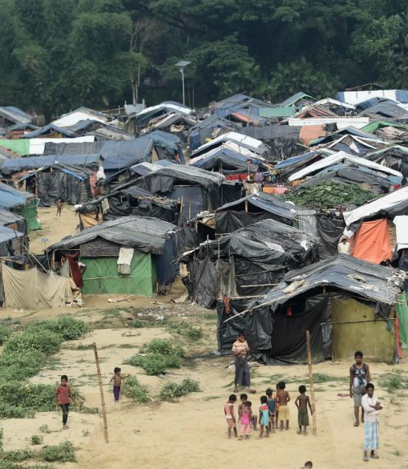
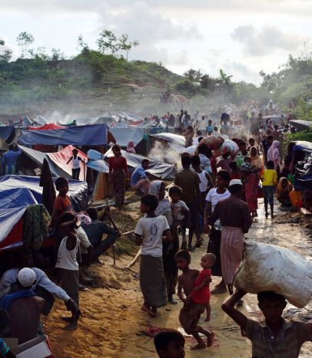
Image Credit: Reuters/Danish Siddiqui
Image Credit: Ye Aung Thuye/AFP/Getty/National Post

Slide 6
Who Are The Rohingya Of Myanmar?
Al Jazeera World News
https://youtu.be/i3PG3lb8mRE

Slide 7
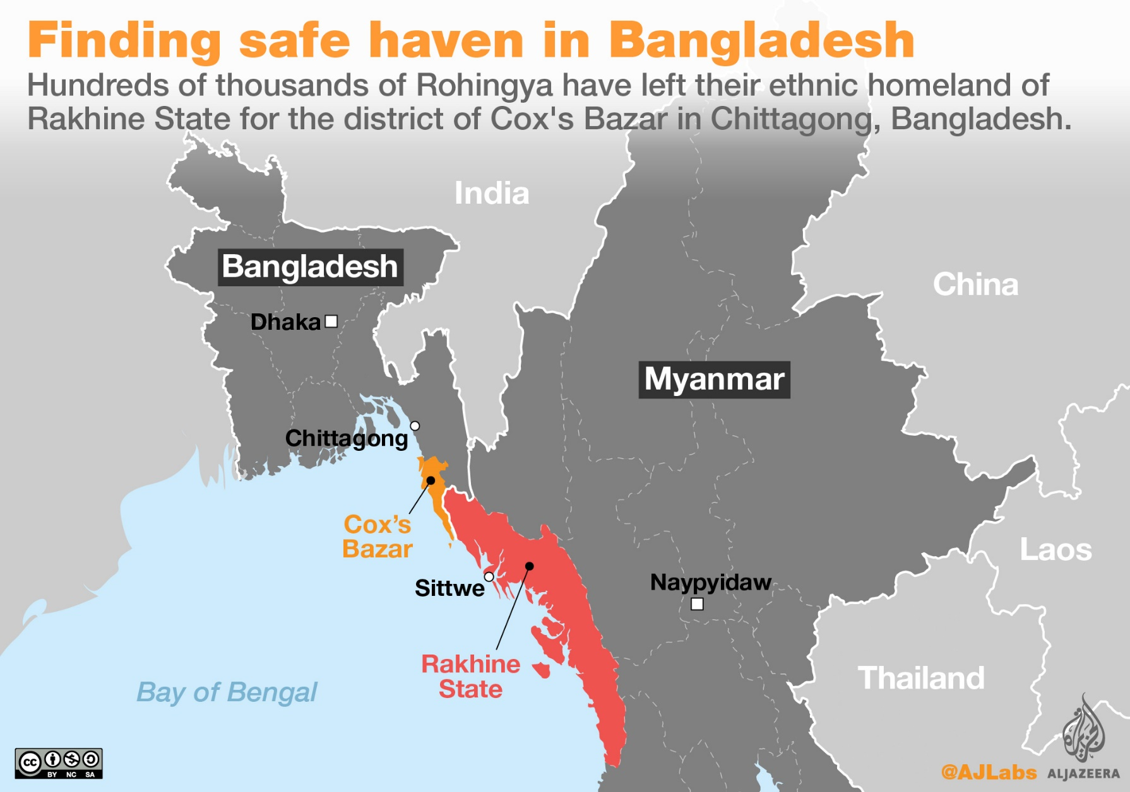
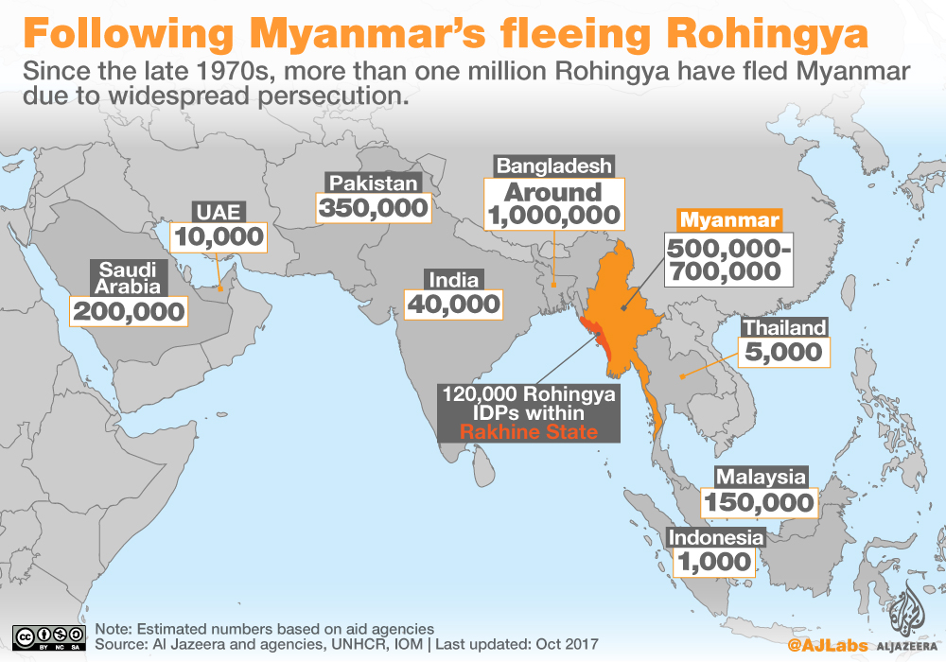
CONTEXT:
Who are the Rohingya?
Why have so many Rohingya been fleeing Myanmar, and where are they going?
How are recent events part of a longer history of persecution and migration?
How has Myanmar’s leader respond to recent events?
Source: https://www.aljazeera.com/indepth/interactive/2017/09/rohingya-crisis-explained-maps-170910140906580.html

Slide 8
Definitions
Ethnic Cleansing: a purposeful policy designed by one ethnic or religious group to remove by violent and terror-inspiring means the civilian population of another ethnic or religious group from certain geographic areas
Refugee: a displaced person who has been forced to cross national boundaries and who cannot return home safely due to war, persecution, or natural disaster
Genocide: acts committed with intent to destroy, in whole or in part, a national, ethnical, racial or religious group

Slide 9
Group Discussion Questions about Personal accounts
What stood out to you in the testimonies?
What were the similarities or differences across the different accounts?
How does reading about the personal experiences of individuals add to what you understood from the news report video?

Slide 10
How does Suu Kyi’s description differ from the news report video and from the individual accounts?
How were the accounts similar/different?
What conclusions can we make about the Rohingya crisis based on the accounts we have investigated?
Which rights in the UDHR are being violated?
Final
Discussion

