Slide 1
SWEATSHOPS
HUMAN RIGHTS VIOLATION?

Slide 2
Where was your clothing made?
Instructions: Check the labels in your clothing or shoes to see which country they were made in.
Questions to consider:
What do you notice about where the items are made?
Do you ever think about where your clothes are made? How about who is making your clothes?
What do you think about when you are buying clothes/items? Cost? Fashion?
Why do you think clothes sold in the United States are made in other countries?
What are some possible pros and cons of getting clothing made internationally?
What kind of conditions do you think the people who produced the items work in?

Slide 3
Definitions
Sweatshops: a factory or workshop where workers are treated unfairly, for example having low wages, working long hours and in poor conditions
Cause: the thing that makes other things happen, why
Effects: results, what happened

Slide 4
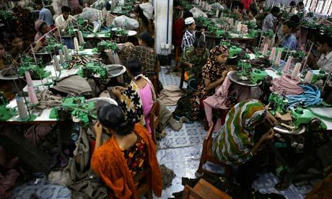
CBS News “Undercover in a Bangladesh clothing factory”
https://youtu.be/W1mvcFuiTts
What are some issues existing in clothing factories?
Why are the working conditions so poor?
https://www.kalw.org/post/today-your-call-how-are-labor-conditions-global-economy-monitored#stream/0

Slide 5
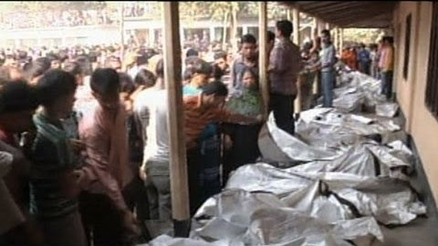
ABC News “Fire Kills Over 100 Factory Workers in Bangladesh”
What are some issues existing in clothing factories?
Why are the working conditions so poor?
https://youtu.be/RTy2ykKBxIY

Slide 6
Questions
What are some issues existing in clothing factories?
Why are the working conditions so poor?
What kind of eﬀects do you think sweatshops could have on the communities/families/locally owned businesses where they are located?
Where do you think the majority of proﬁt and money goes from a sweatshop factory?
Do you think sweatshops provide opportunities for those who are workers? Why or why not?
What if it was you, or your child who was working, would you feel the same?

Slide 7
Cause & Effect Chart [Example]
Causes | Issues | Effects
Aug. 2017 – militant group attacked police in Rakhine state, the group was declared a terrorist organization, this led to a military campaign against the Rohingya 1982 – new citizenship law passes rendering Rohingya stateless | Myanmar military set fire to hundreds of Rohingya villages and opened gun fire Rohingya are not granted Myanmar citizenship even though they have lived there since the 12th century | Thousands of Rohingya fled to Bangladesh and surrounding countries, living in poor conditions as refugees Rohingya people not planning on returning to Myanmar even if the violence stops
Solutions: Allow the Rohingya people citizenship and free/safe entry back into Myanmar Military reform

Slide 8
As you read…
STAR
Place a star near the ISSUES
UNDERLINE
Underline the CAUSES
CIRCLE
Circle the EFFECTS

