Slide 1
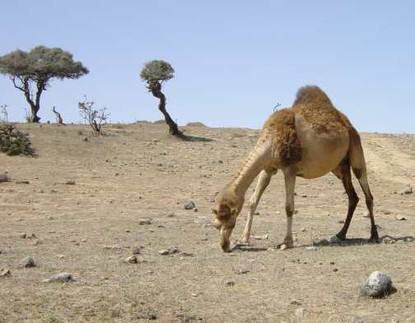
The Middle East

Slide 2
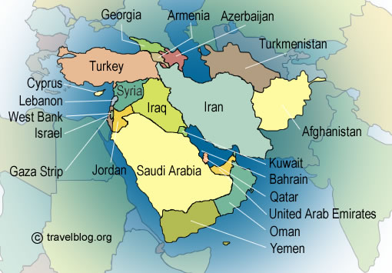

Slide 3
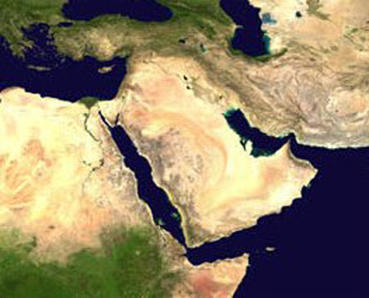

Slide 4
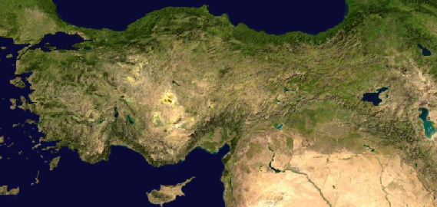
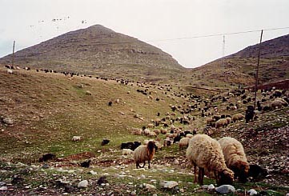
Anatolia

Slide 6
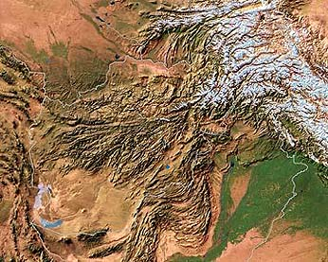
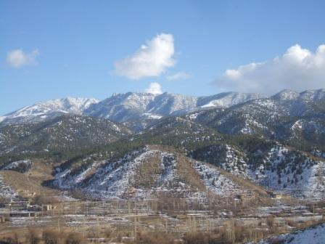
Afghanistan

Slide 8
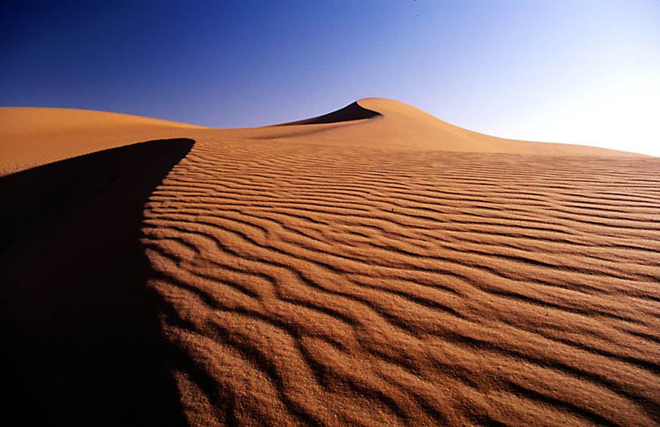
Rub Al-Khali
The Arabian Peninsula

Slide 9
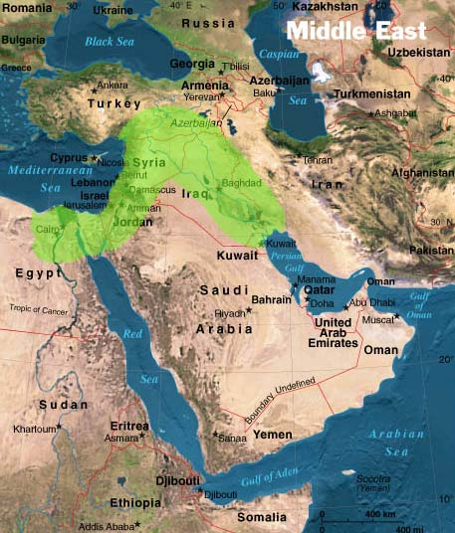
The Fertile Crescent

Slide 10
The Fertile Crescent
A strip of fertile land stretching from the Persian Gulf to the Mediterranean Sea
The cradle of civilization
Surrounded by dry lands and mountains
Tribes of wandering herders often invaded the valley, conquered it, and established empires.
The history of the fertile crescent is one of repeated migration and conquest.

Slide 11
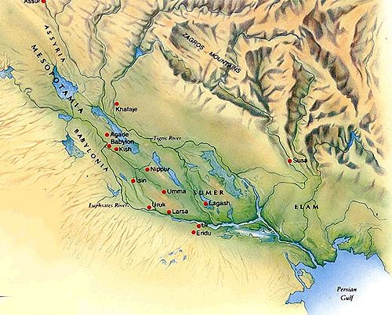
Mesopotamia

Slide 12
Mesopotamia
“Between the rivers” in Greek
The Tigris and Euphrates rivers flow down from the hills into Mesopotamia's low lying plain.
Every year, the rivers bring silt to nourish the soil.
First farm settlements formed around 7000 BC.

Slide 13
The Rise of the Sumerians
Farm settlements gradually developed into cities between 4000 and 3000BC
The cities became the political, religious, cultural, and economic centers of civilizations.

Slide 14
The Rise of the Sumerians
In southern Mesopotamia, a people known as the Sumerians developed the world’s first civilization.
It is unknown when the Sumerians settled in Mesopotamia or where they were originally from.
By 3,000 BC several hundred thousand Sumerians were living in southern Mesopotamia.

Slide 15
City States
The first major cities in Sumer had about 10,000 residents.
By 2,000 BC some of Sumer’s cities had more than 100,000 people.
A city state is an autonomous political unit that includes the city and all the countryside around it.
The amount of countryside controlled by each city state depended on its military strength.
City states fought each other to gain more farmland.

Slide 16
Warring Cities
City states built up strong armies and thick walls around their cities for protection.
Individual city states gained and lost power over time.
Ur, Uruk, Kish were all powerful city states.

Slide 17
Government
Sumer’s earliest governments were controlled by temple priests.
During war time, military commanders would take over. Eventually, some commanders kept control for the government. This paved the way for dynasties.

Slide 18
Sumerian Achievements

Slide 19
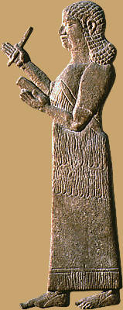
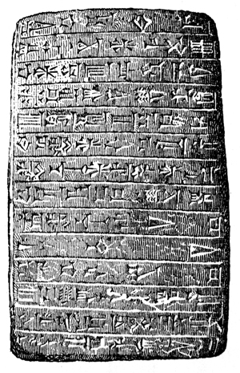
Writing
Wrote with a tool called a stylus
Letters were wedge shaped
The writing was called cuneiform

Slide 20
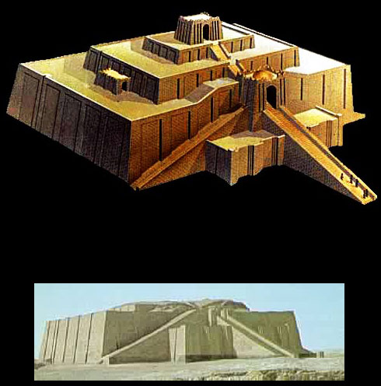
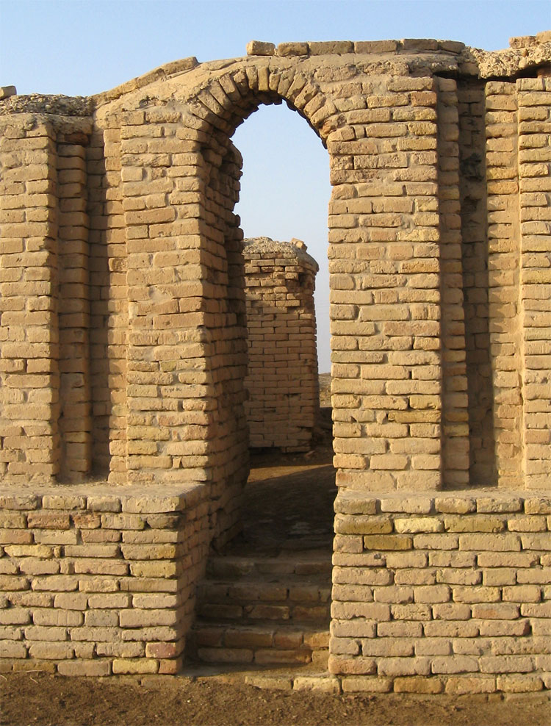
Architecture
Invented the Arch
Invented temples known as ziggurats.

Slide 21
Scientific Achievements
May have been the first people to use the wheel.
Used numbers based on sixty.
The concept of sixty minutes/seconds was developed by the Sumerians.

Slide 22
The Empires of the Fertile Crescent

Slide 23
The Akkadians
A people known as the Akkadians lived just north of the Sumerians.
They spoke a different language, similar to Arabic.

Slide 24
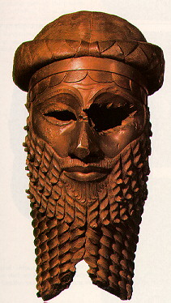
Origins
2,330 BC
A man named Sargon formed a permanent army and launched a series of wars.
He defeated all the city states of Sumer and northern Mesopotamia.
He formed the world’s first empire.

Slide 25
Fall of the Akkadians
Rulers after Sargon were weaker and had trouble protecting the empire.
A century after Sargon’s death new waves of invaders swept through the fertile crescent and the empire collapsed.
City states once again began to war against each other.

Slide 26
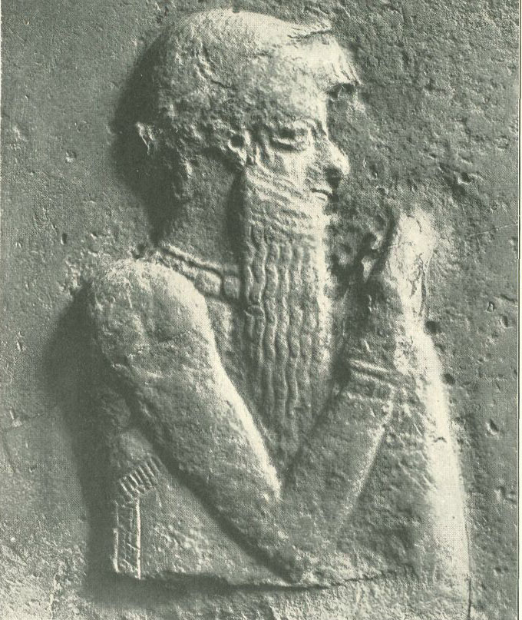
The Babylonians
In 1792 BC a strong ruler named Hammurabi came to power in Babylon.
He conquered most of Mesopotamia.

Slide 27
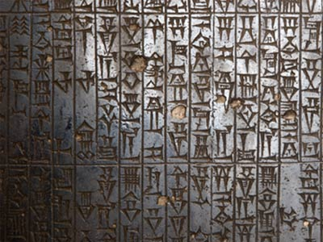
Hammurabi
Outstanding political leader and lawmaker.
Created the Code of Hammurabi.
Collection of 282 laws concerned with all aspects of life in Babylon.
Punishment was harsh and based on the “eye for an eye” principle.
The laws found in the code deal with day-to-day laws in Babylon governing trade, property rights, treatment of slaves, relationships. The code also lists penalties for violating those laws.
The Babylonians were also invaded and conquered by outside forces.

Slide 28
Code of Hammurabi
Stealing: “If any one steal cattle or sheep, or a pig or a goat, if it belong to a god or to the court, the thief shall pay thirty-fold; if they belonged to a freed man of the king he shall pay tenfold; if the thief has nothing with which to pay he shall be put to death.” (# 8)
“If any one break a hole into a house (break in to steal), he shall be put to death before that hole and be buried.” (# 21)
Bearing false witness: “If any one bring an accusation of any crime before the elders, and does not prove what he has charged, he shall, if it be a capital offense charged, be put to death.”(# 3)
Slaves: “If any one find runaway male or female slaves in the open country and bring them to their masters, the master of the slaves shall pay him two shekels of silver.” (# 17)
“If a slave say to his master: "You are not my master," if they convict him his master shall cut off his ear.” (# 282)

Slide 29
Code of Hammurabi
Renting: “If any one hire a ferryboat, he shall pay three gerahs in money per day.” (# 275)
Accidental murder: “If a builder build a house for some one, and does not construct it properly, and the house which he built fall in and kill its owner, then that builder shall be put to death.” (# 229)

Slide 30
Other Empires
The Hittites, the Assyrians, and the Chaldeans each came to power, but eventually fell making way for new empires.
The Persians eventually came to power in 539 BC and ruled for several centuries.

Slide 31
Countries in the Middle East
Turkey
Syria
Afghanistan
United Arab Emirates
Iran
Saudi Arabia
Oman
Jordan
Cyprus
Iraq
Kuwait
Israel
Qatar
Yemen
Lebanon

Slide 32
Sources
http://www.travelblog.org/pix/maps/middle-east.jpg
http://www.italchem.com.tr/anatolia.png
http://rst.gsfc.nasa.gov/Sect7/satellite.jpg
http://farm1.static.flickr.com/43/125567900_46e58e984a.jpg
http://www.public.iastate.edu/~cfford/fertile%20crescent.jpg
http://www.585thengrco.com/pipeline/pics/Afghanistan%20mountains%20II.JPG
http://marbleheadcharter.org/7wiki/images/thumb/e/ec/Mesopotamia.jpg/500px-Mesopotamia.jpg
http://douggeivett.files.wordpress.com/2008/07/cuneiform-writing-1.jpg
http://www.jim-n-mandie.com/blog/uploaded_images/Archway-709875.jpg
http://www.enchantedlearning.com/subjects/continents/Mideast/outlinemap/map.GIF
http://www.historyforkids.org/learn/westasia/art/pictures/sargon.jpg
http://www.news24i.com/images/hammurabi.jpg
http://static.howstuffworks.com/gif/code-of-hammurabi-1.jpg

