Slide 1
B5 - Seating Assignments
Table 1
Thomas Bateman
Weldon Spanbauer
Daniel Barreto Leon
Emma Crofts
Table 2
Jackson Thomas
Samantha Nelson
Daniel Zitzelsberger
Rachel Oswald
Table 3
AJ Alvarado
Eli Mickelson
Isabela De Oliveira
Kourtney Hadlock
Roman Williams
Table 4
Chris White
Shelby Bennett
Cooper Wight
Audrey Bates
Table 5
Jake Olsen
Landon Clark
Malachi Bentley
Emma Wernig
Kade Dubois
Table 6
Gavin McArrthur
Kate Killpack
Wyatt Sorenson
Jasmine Barragan
Sarah Hawkins
Table 7
Layne Black
Michelle Henry
London Winters
Jack Stroud
Table 8
Cooper Thomson
Lindsey Mecham
Isaac Adams
Mya Freeland

Slide 2
B7 - Seating arrangements
TABLE 1
Ethan Adamson
Tobias Wood
Kash Anderson
Grace Johnson
Chloe DeSpain
TABLE 2
Nathan Steed
Cameran Carter
Victor Olsen
Branson Patterson
TABLE 3
Sage Strayer
Benjamin Hammer
Hallee Golding
Zion Fiame
Kate Nielson
TABLE 4
Megan MoYes
Eli Lundgreen
Taylinn Call
Ali Clark
Dayton Brown
TABLE 5
Jacob Ivie
Theo Jan
Bridger Cheney
Jonas Lowe
TABLE 6
Ella Brannelly
Zachary Payton
Jacob Price
Aspen Conover
TABLE 7
Landon Tinsley
Emily Reeves
Payton Howell
Evie Crotts
Ryan Allred
TABLE 8
MaKaylie Roberds
Kay Adamson
Nathan Shepherd
Savannah Beck
Marcelo Roman

Slide 3
B8 - Seating arrangements
Table 1
Breckan Hickman
James Kelley
Connor Stanley
Jason Terry
Table 2
Addison Badertscher
Brooklyn Ruesch
Serena Phillippe
Ben Jenkins
Table 3
Maleah Masters
Odessalyn Bartlett
Timothy Layne
Chloe Dallin
Garrett Weber
Table 4
Easton Allred
Kevin Quinones
Kierra Stout
Emma Zufelt
McGwire Madsen
Table 5
Talon Walston
Lauren Hardle
Max Chacon Arreola
Boston Miner
Analeen Liufau
Table 6
Ian Hawkins
Jesse Smith
Preston Varner
Cami Nelson
Grant Whitehead
Table 7
Aspen Turner
Porter Sabin
Jaden Bair
Natalie Ellsworth
Table 8
Adelle Cunningham
Matthew Fish
Natalie Fish
Boston Bingham

Slide 4
Journal Write: Analyze this Indus River Valley Artifact
When analyzing an artifact…
Observe its parts.
Think about: shape, color, texture, size, movable parts, or anything written on it.
Try to make sense of this artifact.
Pick TWO questions to answer, as best as you can, about this artifact.
Who used it? List reasons you think so.
What was it used for? List reasons you think so.
What does this tell you about the people who made and used it?
What does it tell you about technology at the time it was made?
***Remember: ½ page = 12 lines

Slide 5
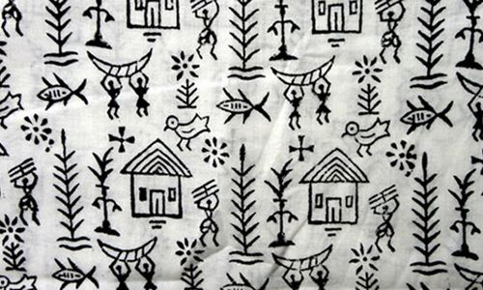
Indus river valley civilization
Unlocking the Secrets of Mohenjo-Daro
Artifact Activity

Slide 6
What can artifacts tell us about daily life?
Artifact: an object made by a human being, a primary source
Hypothesis: a proposed explanation for the usage of an artifact based on observation
https://youtu.be/4tzs1gncsHM

Slide 7
Activity instructions:
Look at the picture of the artifact
For help…questions will be on the screen to get you thinking
Record answer to question #1 under the correct station letter (The picture has a letter on it, that is the station letter
For each picture, you will have 2 minutes
After time runs out, pass the picture to the next group
Afterwards…we will answer question two together as a class

Slide 8
Consider these questions when analyzing an artifact…
Who made it?
Who used it?
What was it used for? What does it do?
How did someone make it?
What tools were used to make it?
What does this tell you about the people who made and used it?
https://youtu.be/4xG2aJa6UyY

Slide 9
Let’s discuss…
What can artifacts tell us about daily life?
***Reward for those who get the most correct!

Slide 10
Station a
Archaeologists believe these were…
Weights and a Scale

Slide 11
Station b
Archaeologists believe this was…
The Great Bath

Slide 12
Station c
Archaeologists believe these were…
Statue and Beads

Slide 13
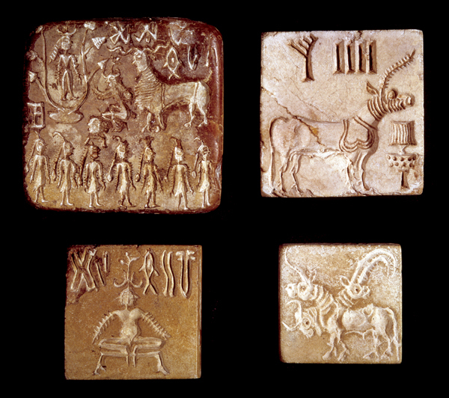
Station d
Archaeologists believe these were…
Seals

Slide 14
Station e
Archaeologists believe this was…
The Sewer System

Slide 15
Station f
Archaeologists believe these were…
Homes

Slide 16
Station g
Archaeologists believe these were…
Games

Slide 17
Station h
Archaeologists believe this was…
A Clay Toy Model

