Slide 1
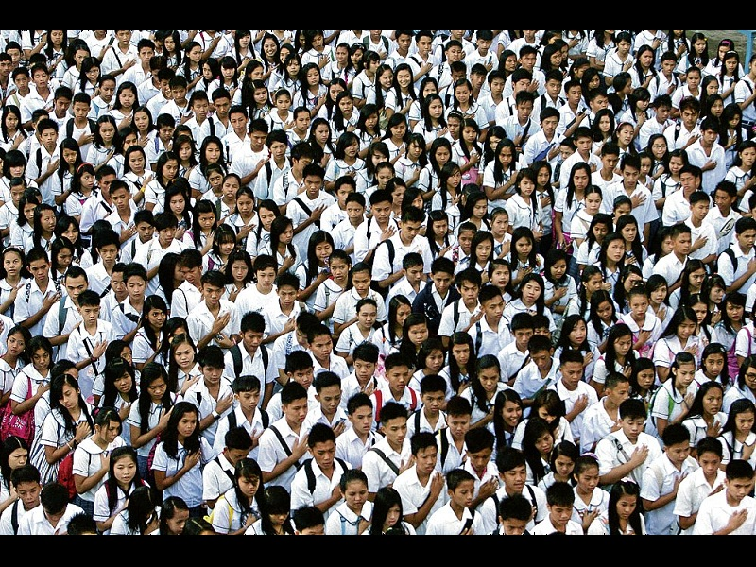
Population Day 1

Slide 2
Lesson Objectives
Students will be able to describe two main reasons why the world’s population is rapidly increasing.
Students will be able to explain some of the problems that rapid population growth is causing.
Notes:
2

Slide 3
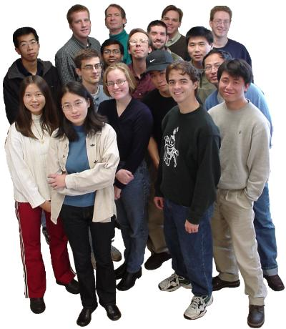
Counting People: Population
Population is the total number of people who live in a particular place.
Geographers study population to understand where people live and why they live there.
Notes:
3

Slide 4
Demography
The study of population is called demographics.
Scientists who study demographics are called demographers.
Notes:
4

Slide 5
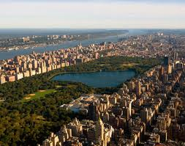
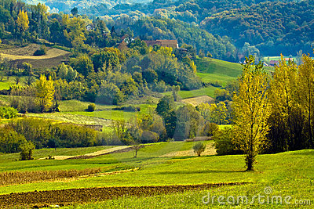
Urban vs. Rural
Half of the earth’s people live in cities and towns. This is called urban.
The other half live on farms or in countryside villages. This is called rural.
Notes:
5

Slide 6
Urban Words
City, or metropolis – a large or important town.
Megalopolis – very big city, having cities grow into each other. Wasatch Front, New York,
Suburbs – residential districts lying just outside a city. Referred to sometimes as bedroom communities.
Eagle Mtn, Ranches, Saratoga Springs?

Slide 7
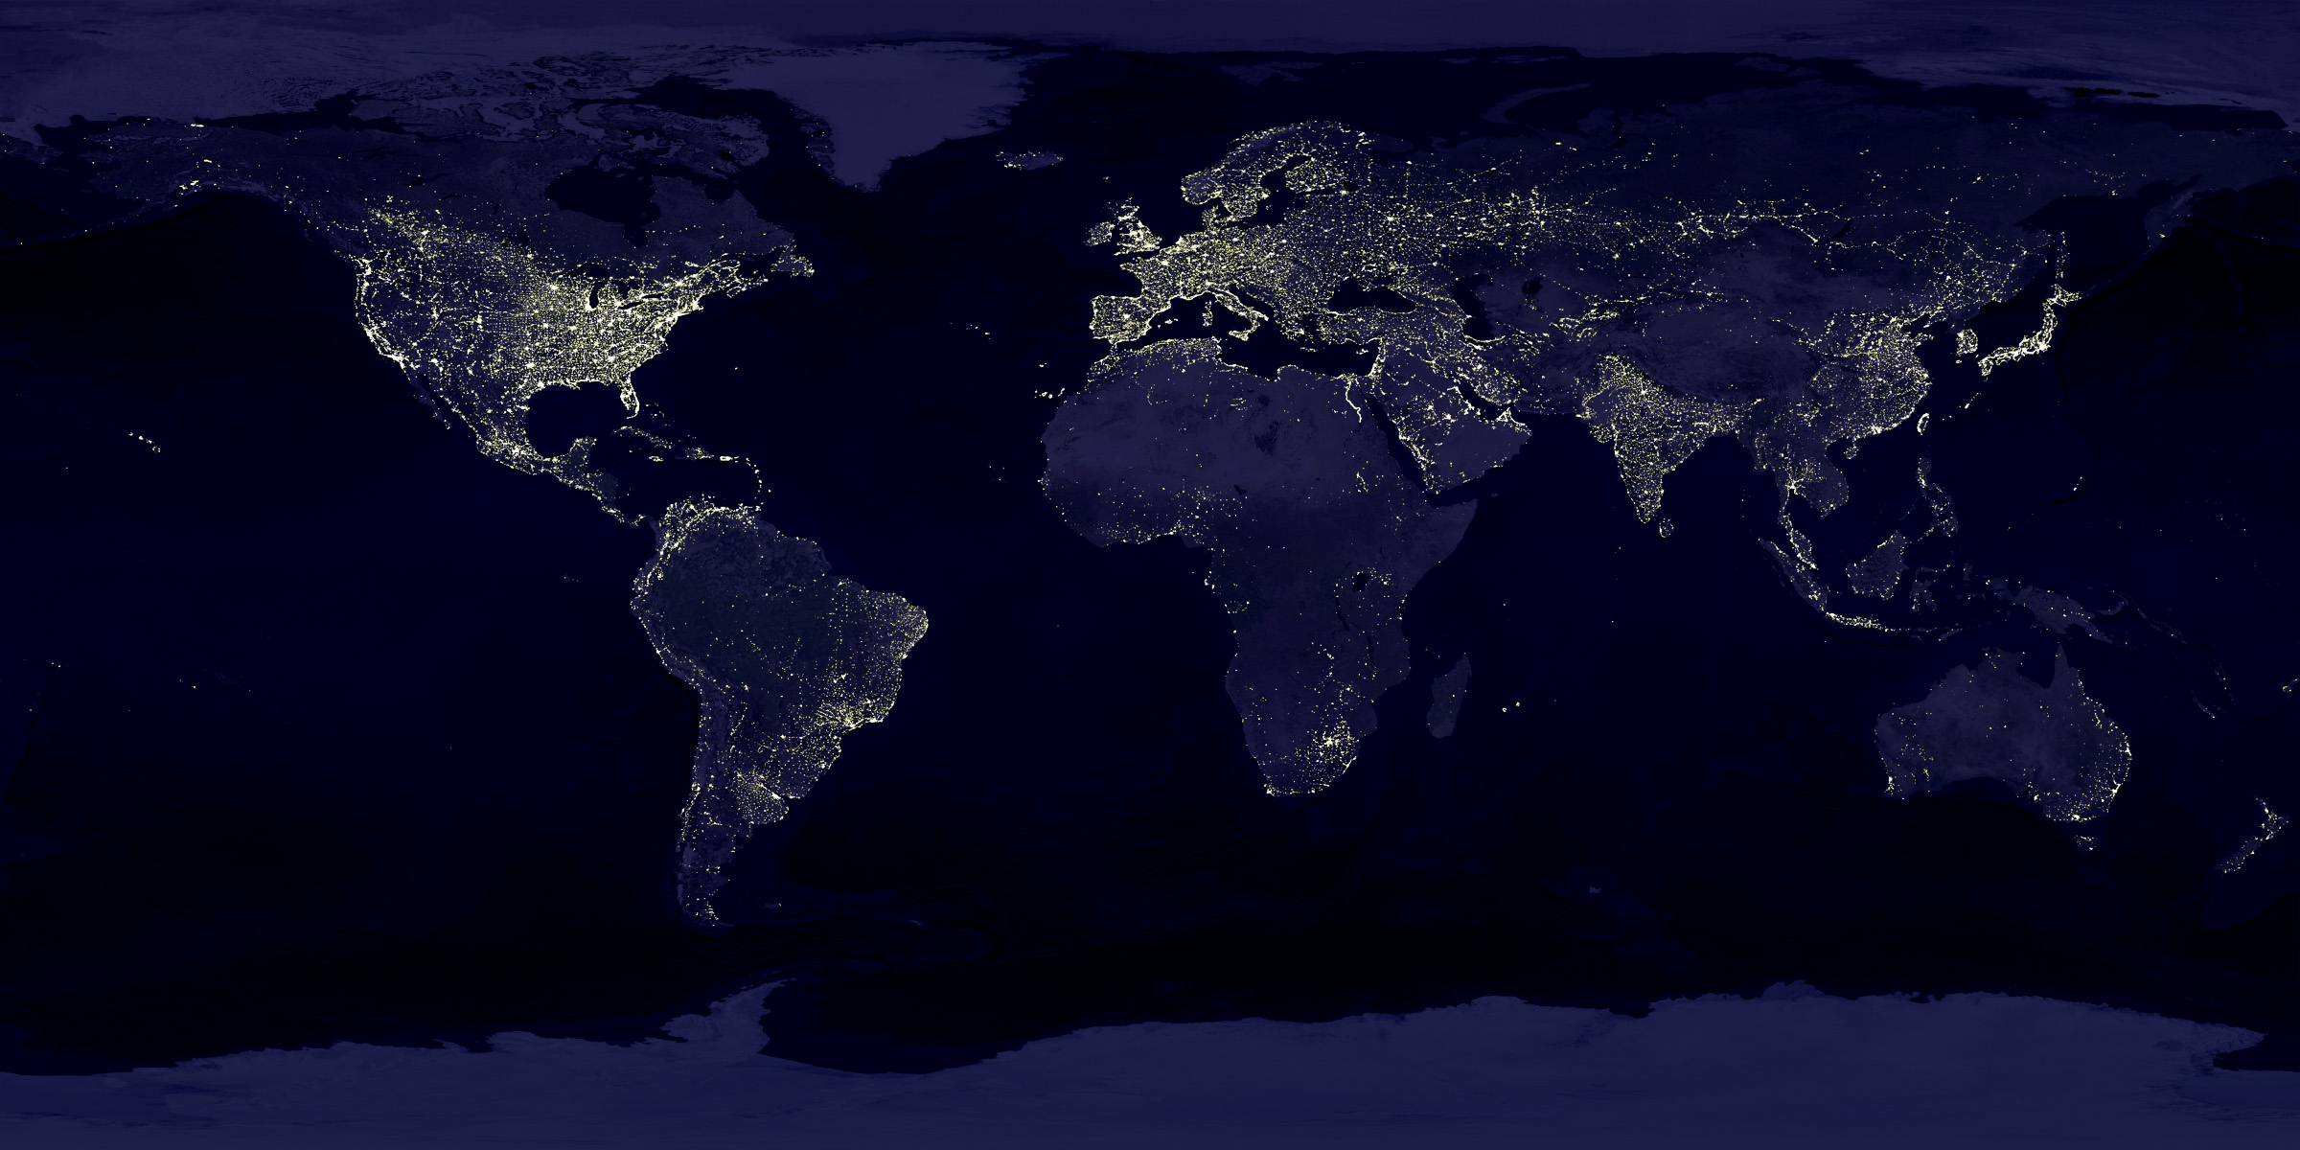

Slide 8
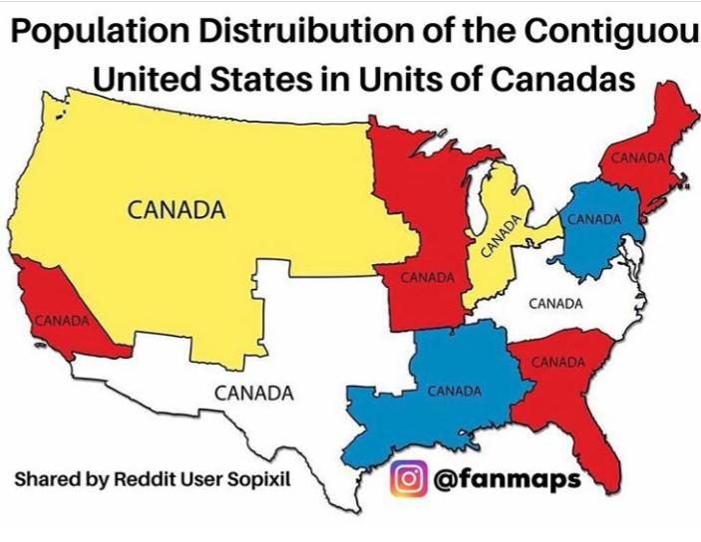
Each area shown on this map of the USA, has the same population as the entire country of Canada!

Slide 9
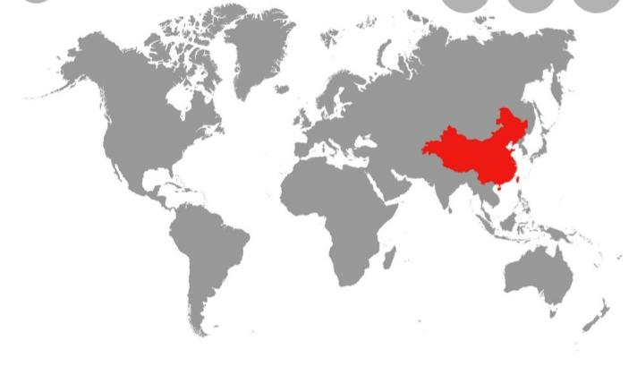
What is Population Density?

Slide 10
STOP! HAND OUT POPULATION GUESSING
Have Students respond to the prompt of Part 1 of the hand out.
China’s population is roughly 1.4 billion People and growing. The world’s population is nearly 8 billion people. Below is a map of the world, with only China’s borders defined. I want you to guess three areas that you think would have a similar population size to China and I want you to draw a circle around them. After we have all done so, we will review!

Slide 11
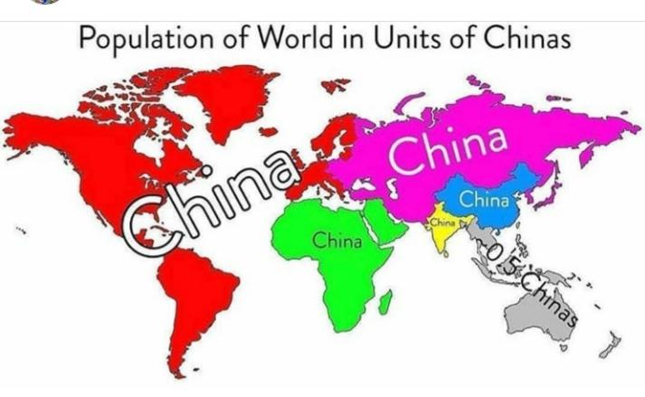
Do you guess correctly?

Slide 12
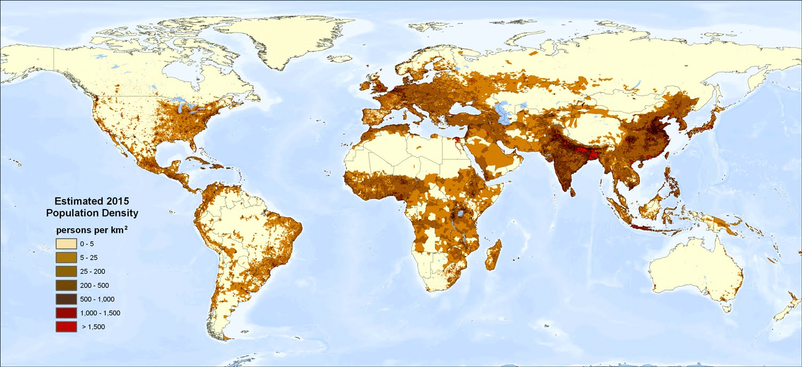
Population Density
Notes:
12

Slide 13
What do you notice about this map?
Are their any countries missing?

Slide 14
Largest Countries
By Area (sq. miles)
Russia 6,592,800
Canada 3,851,809
China 3,732,396
USA 3,691,795
Brazil 3,286,470
Australia 2,966,136
By Population
China: 1.4 billion
India: 1.3 billion
USA: 327 million
Indonesia 261 million
Brazil 207 million
Pakistan 205 million
9th Russia 142 million
Canada 36 million
Notes:
14

Slide 15
Answer the following individually or in a group.
Why Do you think Geographers study population size?
What do you think population density means?
Do you think that there are any correlations between a population’s size and its wealth?

Slide 16
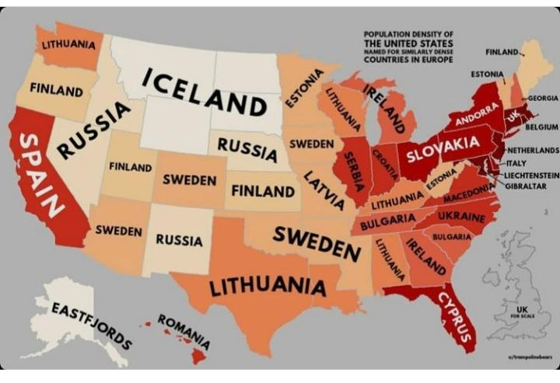
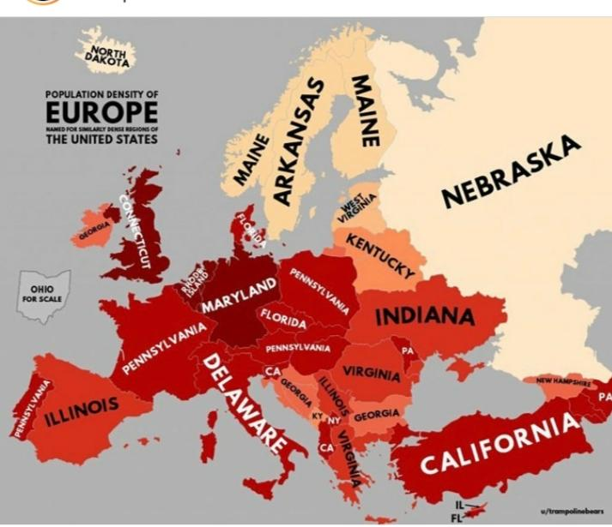

Slide 17
Population Part 2
Why is the world’s population growing so fast?

Slide 18
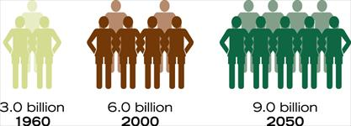
How fast is the World Growing?
The world’s population increases by about three people every second. That’s nearly 200 people a minute, 10,000 people an hour, and 240,000 people a day.

Slide 19
World Calculator
://www.worldometers.info/world-population/
http://www.worldometers.info/world-population/#top20

Slide 20
Population Data
Average Family Size
The average number of children in a family in a particular culture group or region./ FUN FACT: Utah has the nation's largest average household size, 3.14 people compared to a national average of 2.64
Birth Rate
The number of babies born per year per thousand people.
Death Rate
The number of people who die per year per thousand people.
Doubling Time
The time needed for a population to increase 100 percent (double)

Slide 21
Life Expectancy
-The average number of years people live.
Population Growth Rate
-How quickly a population grows each year, measured by percentage.

Slide 22
Population Pyramid
is a bar graph that depicts a total population by breaking it down into age groups and gender.
Population Density
Means how close together people live in a particular place.
To find population density, divide the number of people in a place by the total area of that place.
Notes:
22

Slide 23
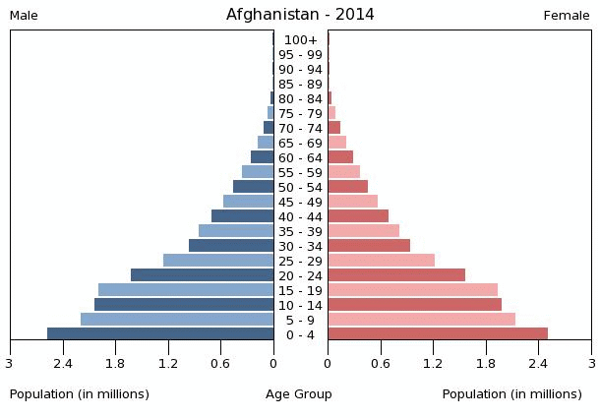
Population Pyramid: Afghanistan
How many females in your age group?
How many males?
Notes:
23

Slide 24
China

Slide 25
United States

Slide 26
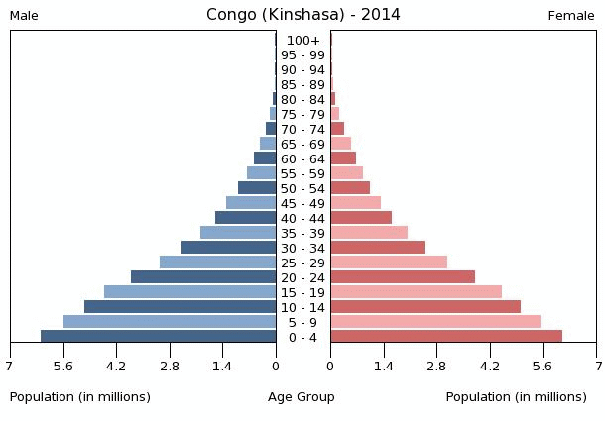
Population Pyramid: Congo
How many females in your age group?
How many males?

Slide 27
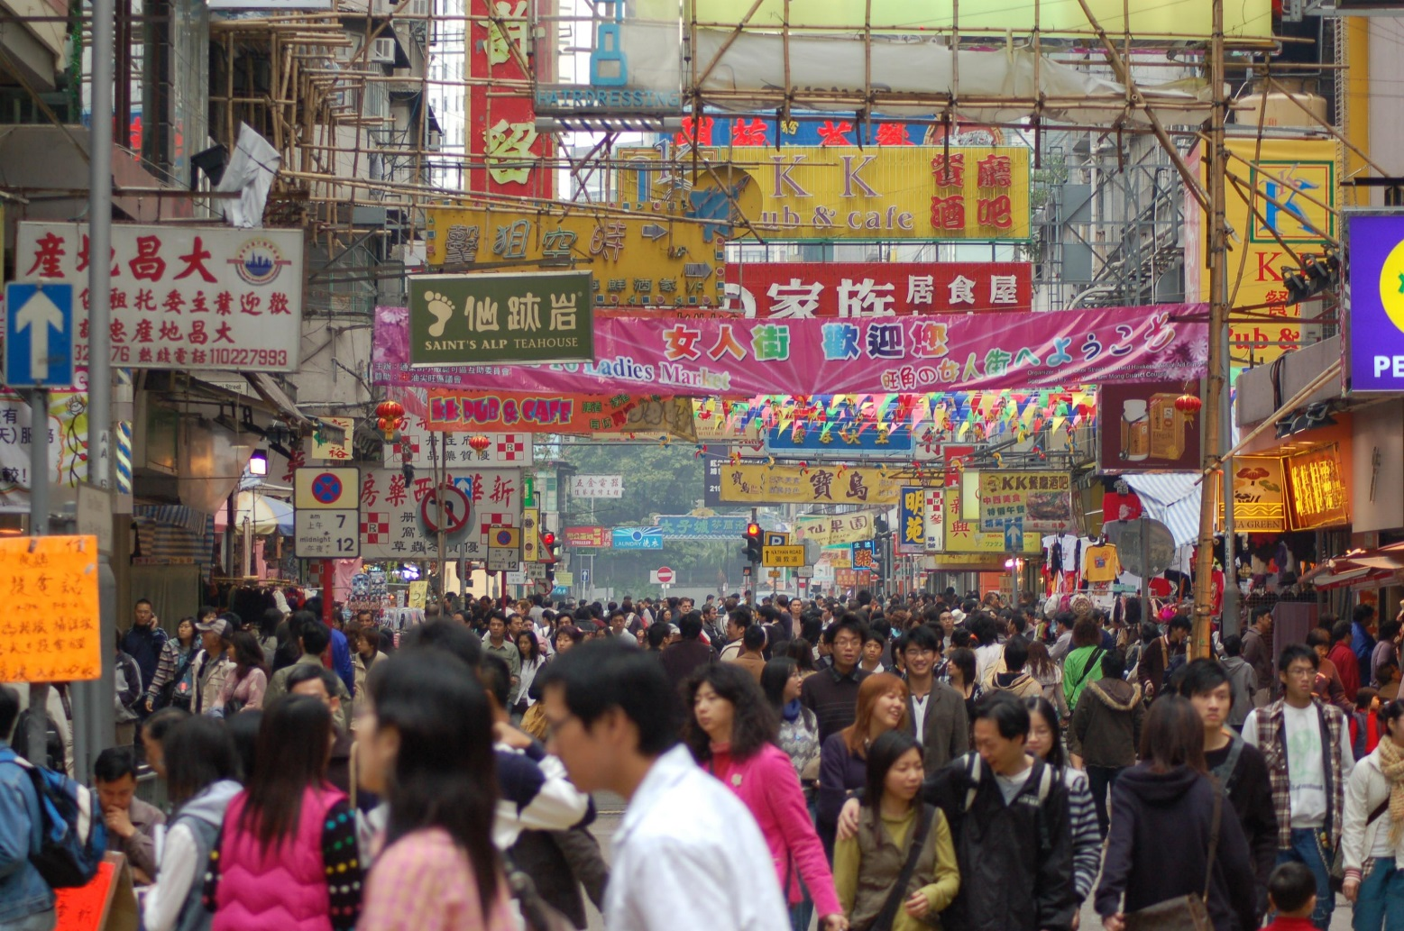
Hong Kong –one of the most densely populated places in the world.
Notes:
27

Slide 28
Distribution of World’s Population Cartogram

Slide 31
Doubling
Imagine that all the years from A.D. 1 to the year A.D. 2000 took place in just 24 hours. Now you have an imaginary clock to measure how fast the world’s population is growing. The list below shows that the Earth’s population doubled several times in those 24 hours.
12:00 a.m. 200 million people in the world
7:48 p.m. Population doubles to 400 million
10:12 p.m. Population doubles to 800 million
11:00 p.m. Population double to 1.6 billion
11:35 p.m. Population doubles to 3.2 billion
11:59 p.m. Population will double to 6.4 billion
During the 24 hours, how many times has the world’s population doubled. How long did it take for the world population to double the first time? The last time?
Notes:
31

Slide 32
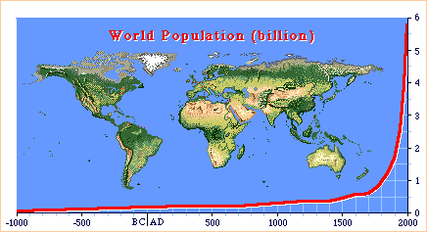
B.C. to 2000 World Population
What was the world’s population in 1800?
A.1.5 Billion B.1 Billion
C.3 Billion D..5 Million
Notes:
32

Slide 33
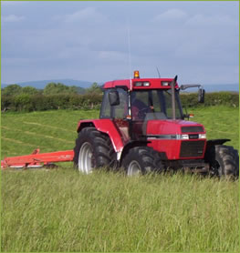
Reasons for Population Growth
Farming methods have greatly increased the world’s food supply.
Green Revolution – protect crops, less water, new fertilizers, and new varieties.
Notes:
33

Slide 34
Reasons for Population Growth
Scientific Advancements in Medicine and Health.
Surgery
Vaccines
Preventative
Antibiotics
Notes:
34

Slide 35
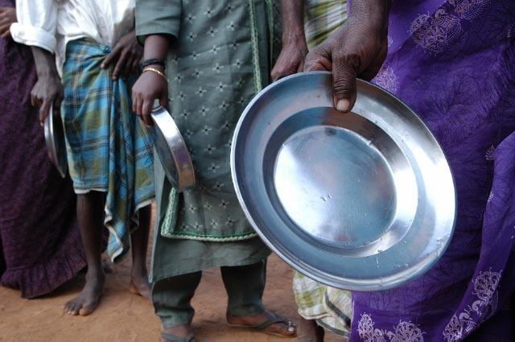
The Challenges of Population Growth
Using resources faster
Shortage of fresh water
Shortage of energy
Scarcity of food
Not enough money to purchase food
People of India spend 80% of money on food.
United States less than 10%

Slide 36
The Challenges of Population Growth
People can’t find jobs.
Not enough schools to educate the growing number of children
Public services like transportation and sanitation are inadequate.
Deforestation – India and Pakistan
Lack of trees affect the supply of clean air.

Slide 37
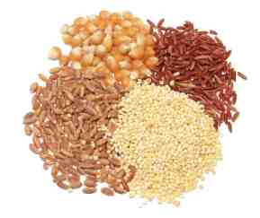
How much grain do…
Americans consume?
approximately 2,000 lbs/year.
poorer people like Indians consume?
approximately 400 lbs/year.
Americans consume directly (food grains)?
only 150 lbs. (most is fed to livestock)
Indians consume directly (feed grains)?
almost all: little can be spared for animals.

Slide 38
Some countries use more than their fair share of resources
It takes 5 times as much soil, water, & fertilizer to feed a person in the U.S. than in places like India!

